Slide 1

INSIGHTLENS
ANALYZE YOUR FEEDBACK SMARTLY
BUSINESS PLAN

Slide 2
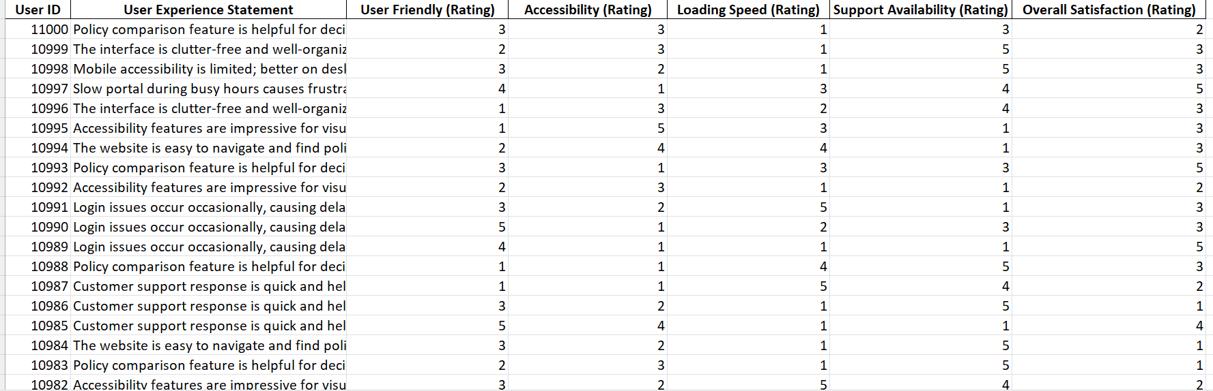
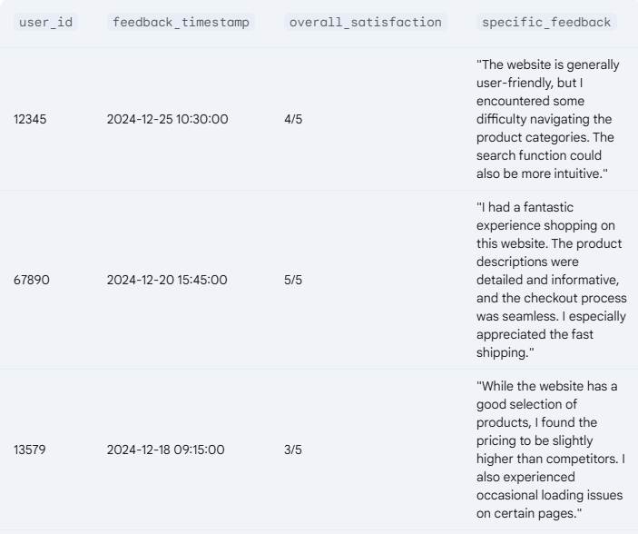
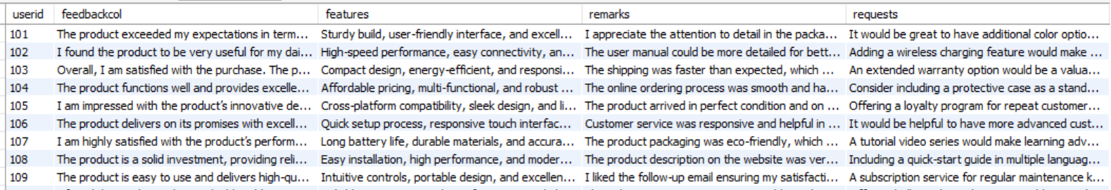
IDEA OVERVIEW
Many companies struggle to
analyze and act on customer
feedback effectively.
InsightLens bridges this gap by
providing automated feedback
analysis.
Goal: Help businesses enhance
user experience through
simplifed understanding of their
customers voices.

Slide 3

SOLUTION
InsightLens can help product managers save time reading survey results.
An AI integrated tool that will read, analyze and present critical information from the survey results in a structured, categorized manner.
The product will also help to generate user stories when integrated with project management softwares like Jira and Mastercraft DevPlus.

Slide 4
COMPANY OVERVIEW
01
02
Problem Statement
Solution
Growing need for customer sentiment analysis.
Saas based digital product InsightLens intened to help businesses understand their customers better through continuous feedback analysis.
03
04
Mission
Vision
Empower businesses with structured customer insights.
Transform feedback into actionable improvements instantly.

Slide 5
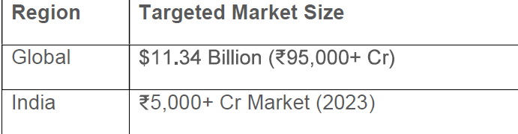


MARKET ANALYSIS
TAM:
Industry: Growing demand for smart feedback
analytic tool (17.5% CAGR).
Market Segments:
E-commerce & Retail: Improve product offerings.
SaaS & Tech Startups: Optimize digital experiences.
Service-Based Businesses: Enhance customer
service.
Enterprise Corporations: Data-driven customer retention.
Market Opportunity: Indian market estimated at ₹5000+ Cr (2023) with 22% CAGR.

Slide 6


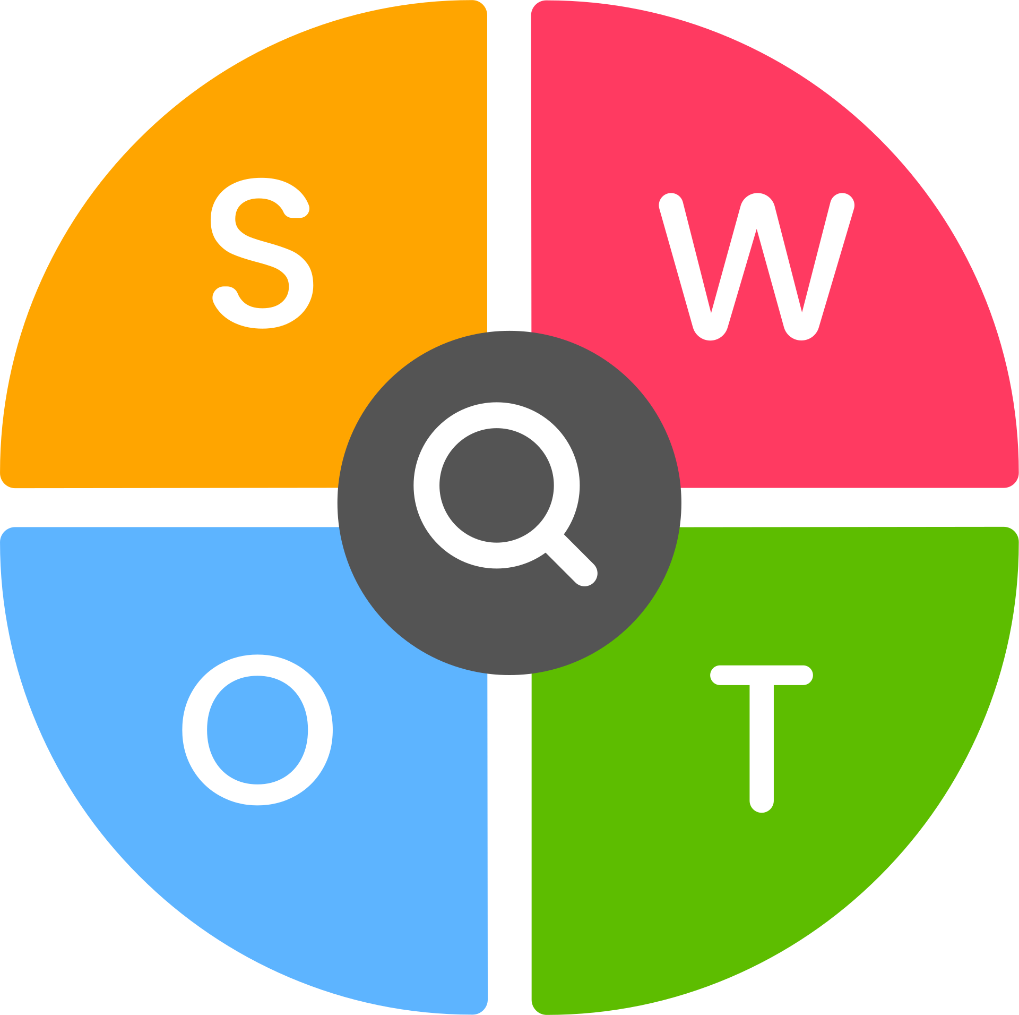
AI-powered sentiment analysis
Feedback categorization
Competitive pricing
SaaS integration
Automated recommendations
Scalable model
Market awareness challenges
High product development cost
Expensive technology
Customer trust in the initial phase
Strong customer support requirement
Growing CX & SaaS industry (17.5% CAGR)
High demand for AI driven tools
Rapid digitalization
Government support for startups
Emerging market advantages
Competition form Qualtrics,
Medallia and other players
Risk of technology obsolescence
Data privacy & security concerns
Price wars from large competitors

Slide 7

BUSINESS MODEL
Trial Version
Free for 30 days
Enterprise Version
₹15,000-₹50,000/month
Pro Version
₹2,000-₹5,000/month

Slide 8
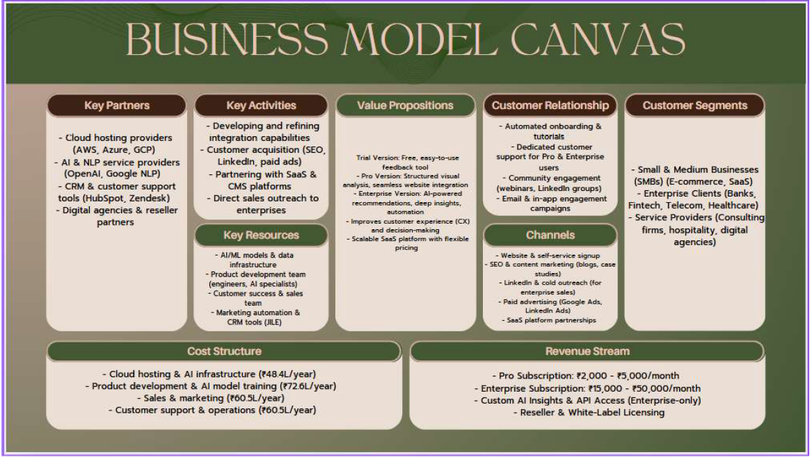

Slide 9
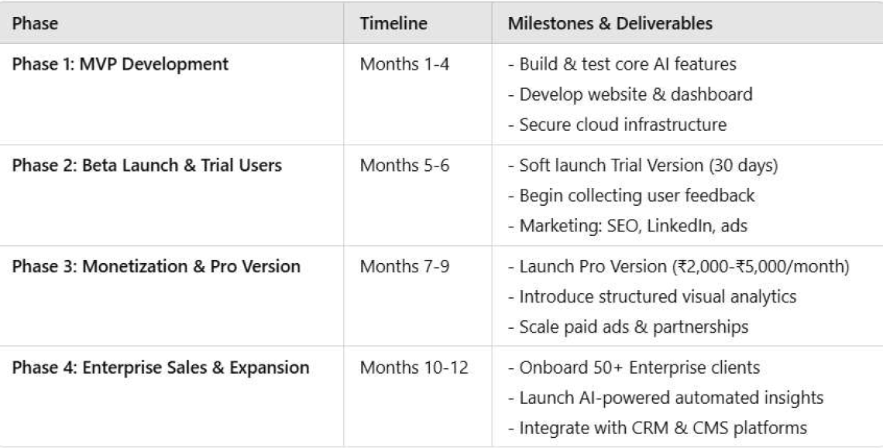
OPERATING PLAN
Teams Involved: Product Development, Sales, Marketing, Customer Support.

Slide 10









COMPETITOR ANALYSIS
PRODUCT DIFFERENTIATION
MAJOR MARKET SHAREHOLDERS
Affordable AI-powered analytics for businesses of all sizes.
Automated insights reduce manual
effort.
Freemium model to acquire and convert users.
Seamless integration with websites and SaaS tools.

Slide 11

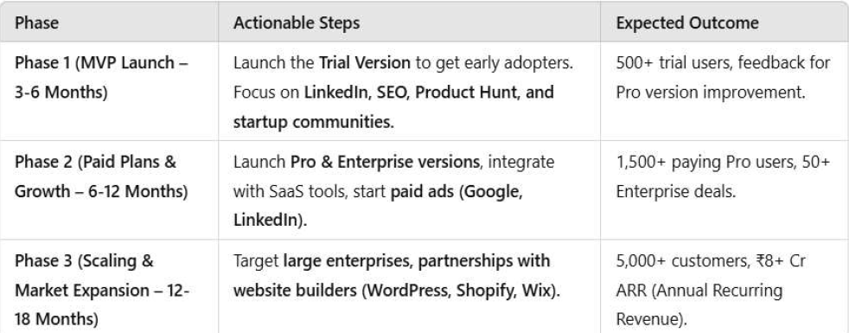
MARKETING STRATEGY
GO-TO-MARKET PLAN

Slide 12


SALES STARTEGY
Trial Version - Generate leads, customer awareness, acquisition
Sales tactics - run LinkedIn & SEO campaigns, Capture leads via website forms &
community groups.
01.
Pro Version - convert small-medium businesses, mass adoption
Sales tactics - automated email sequences to nurture leads, offer limited-time discounts to convert free users.
02.
Enterprise Version - direct sales for high-value clients. premium sales & expansion
Sales tactics - cold outreach to decision-makers (LinkedIn, email), webinars & case studies to showcase ROI, offer custom pricing & integrations for large clients.
03.

Slide 13

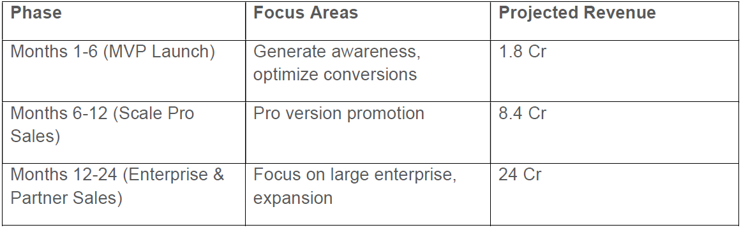
FINANCIALS
Funding Requirement: ₹2.42 Cr (Seed Round for MVP & Marketing).
ESTIMATED COST:
Technology & Infrastructure: ₹48.4L
Product Development: ₹72.6L REVENUE PROJECTION(Years 1-3):
Operations & Staffing: ₹60.5L
Marketing & Growth: ₹60.5L

Slide 14
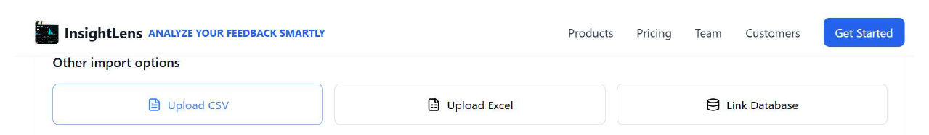
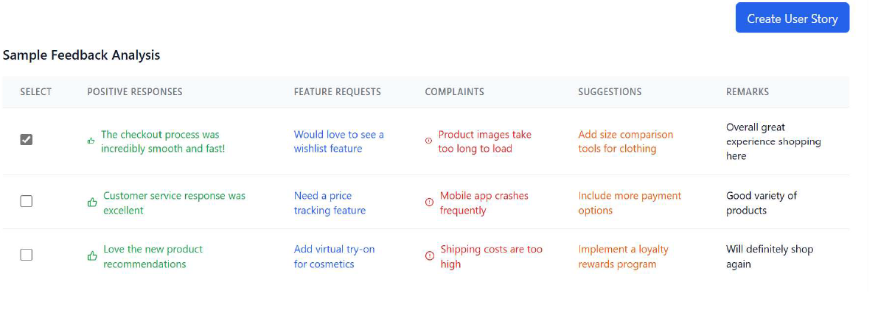
PRODUCT OVERVIEW

Slide 15

SAVE
20 hours of reviews reading
100 hours of feedback analysis
10 hours of creating user stories

Slide 16
SOURCES
https://www.kraftful.com
https://loquacious-profiterole-fde789.netlify.app/ https://bolt.new/~/sb1-caqor1s4
https://www.surveymonkey.com https://www.hotjar.com https://www.zendesk.com/in/contact/
https://www.medallia.com/
https://www.qualtrics.com/
https://www.xm.com/
https://myhr.peoplestrong.com/sessionTimeout.jsf
https://www.keka.com/
https://www.softwaresuggest.com/survaider
https://www.zoho.com/desk/login.html
https://www.ibm.com/think/topics/artificial-intelligence-business-use-cases
https://www.capterra.com/p/174908/Survaider/
https://www.techtarget.com/searchenterpriseai/tip/9-top-applications-of-artificial-intelligence-in-business
https://www.kellton.com/kellton-tech-blog/how-ai-and-ml-will-shift-digital-customer-experience
https://www.kraftful.com/
https://olvy.co/customers
https://www.launchnotes.com/blog/top-product-feedback-tools-every-product-manager-should-consider
https://userpilot.com/blog/product-feedback-management/
https://www.reverselogix.com/industry-updates/7-reasons-why-customers-return-products/

Slide 17
THANK YOU
Suprabha Kumari
2024PGX154

